Slide 1
Introduction to Agile Approach
“A good plan violently executed now is better than a perfect plan executed next week” - General George S. Patton

Slide 2
History of Agile Manifesto
The agile movement officially began with the creation of the Agile Manifesto in February 2001 (Beck 2001)
Agile Manifesto Value:
Individuals and interactions over processes and tools
Working software over comprehensive documentation
Customer collaboration over contract negotiation
Responding to change over following a plan

Slide 3
Agile Project Approach
Work as a team
Work in short iteration
Delivering each iteration
Focus on Business Priority
Inspect and adapt

Slide 4
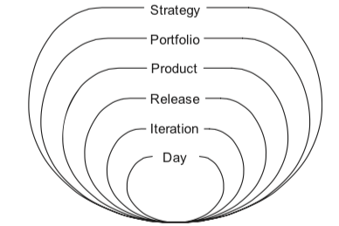
Onion Agile Planning

Slide 5
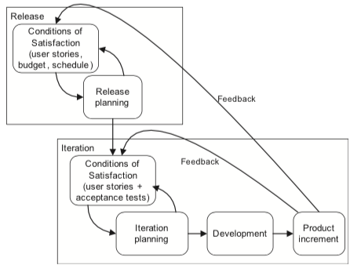
Condition Satisfaction

Slide 6
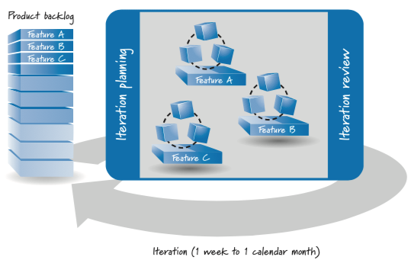
Agile Software Development Overview

Slide 7
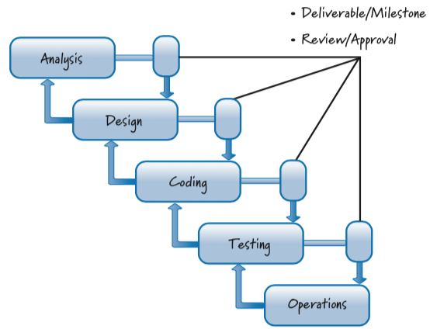
Plan-Driven Development
One pure form of traditional, plan-driven development frequently goes by the term waterfall
Plan-driven development works well if you are applying it to problems that are well defined, predictable, and unlikely to undergo any significant change

Slide 8
Plan-Driven Smell Bad
For many, a plan-driven, sequential process just makes sense, understand it, design it, code it, test it, and deploy it, all according to a well-defined, prescribed plan
If applying a plan-driven approach doesn’t work, the prevailing attitude is that we must have done something wrong
It’s that plan-driven approaches are based on a set of beliefs that do not match the uncertainty inherent in most product development efforts

Slide 9
Agile Principles
Variability and uncertainty
Prediction and Adaptation
Validated Learning
Work in Process
Progress
Performance

Slide 10
Variability and uncertainty
Embrace Helpful Variability
Employ iterative and incremental development
Leverage variability through inspection, adaptation, and transparency
Reduce all forms of uncertainty simultaneously

Slide 11
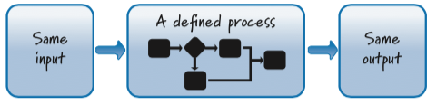
Embrace Helpful Variability
Plan-driven processes treat product development like manufacturing, they shun variability and encourage conformance to a defined process
The problem is that product development is not at all like product manufacturing
In product development, however, the goal is to create the unique single instance of the product, not to manufacture the product
Only once we have the recipe do we manufacture the product—in the case of software products, as easily as copying bits

Slide 12
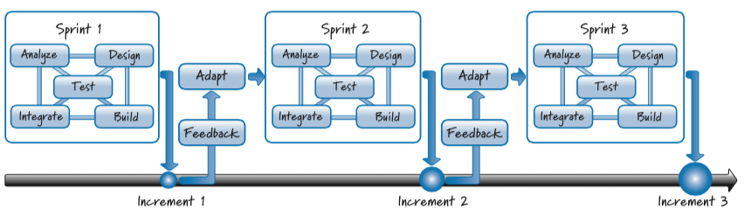
Employ iterative and incremental development
Plan-driven, sequential development assumes that we will get things right up front and that most or all of the product pieces will come together late in the effort
Scrum, on the other hand, is based on iterative and incremental development
In product development, however, the goal is to create the unique single instance of the product, not to manufacture the product
Incremental development is based on the age-old principle of “Build some of it before you build all of it.”

Slide 13
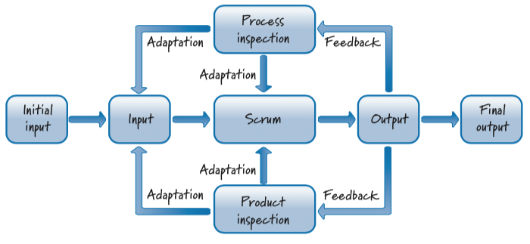
Leverage variability through inspection, adaptation, and transparency
A plan-driven, sequential development process assumes little or no output variability. It follows a well-defined set of steps and uses only small amounts of feedback late in the process
Scrum embraces the fact that in product development, some level of variability is required in order to build something new
Scrum also assumes that the process necessary to create the product is complex and there- fore would defy a complete up-front definition
In Scrum, we inspect and adapt not only what we are building but also how we are building it

Slide 14
Leverage variability through inspection, adaptation, and transparency
Dimension | Plan-Driven | Scrum
Degree of process definition | Well-defined set of sequential steps | Complex process that would defy a complete up-front definition
Randomness of output | Little or no output variability | Expect variability because we are not trying to build the same thing over and over
Amount of feedback used | Little and late | Frequent and early

Slide 15
Reduce all forms of uncertainty simultaneously
Such an approach allows us to opportunistically probe and explore our environment to identify and learn about the unknown unknowns (the things that we don’t yet know that we don’t know) as they emerge
In Scrum, we do not constrain ourselves by fully addressing one type of uncertainty before we address the next type
Scrum take a more holistic approach and focus on simultaneously reducing all uncertainties (end, means, customer, and so on)

Slide 16
Prediction and Adaptation
Keep option open
Accept that you can’t get it right up front
Favor an adaptive, exploratory approach
Embrace change in an economically sensible way
Balance predictive up-front work with adaptive just-in-time work

Slide 17
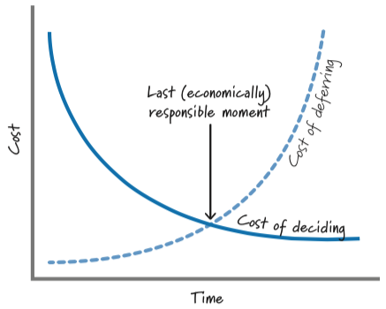
Keep Option Open
Plan-driven, sequential development requires that important decisions in areas like requirements or design be made, reviewed, and approved within their respective phases
The problem is that product development is not at all like product manufacturing
Scrum team delay commitment and do not make important and irreversible decisions until the last responsible moment. And when is that? When the cost of not making a decision becomes greater than the cost of making a decision

Slide 18
Accept that you can’t get it right up front
Plan-driven processes not only mandate full requirements and a complete plan; they also assume that we can “get it right” up front
What’s worse is that when the requirements do change, we have to modify the baseline requirements and plans to match the current reality
In Scrum, we acknowledge that we can’t get all of the requirements or the plans right up front. In fact, we believe that trying to do so could be dangerous because we are likely missing important knowledge, leading to the creation of a large quantity of low-quality requirements

Slide 19
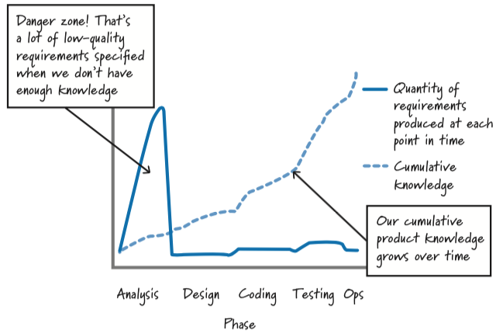
Accept that you can’t get it right up front

Slide 20
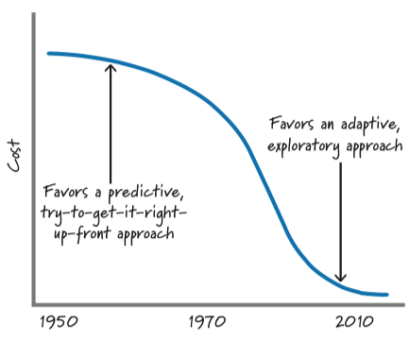
Favor an adaptive, exploratory approach
Plan-driven, sequential processes focus on using (or exploiting) what is currently known and predicting what isn’t known
Scrum favors a more adaptive, trial-and- error approach based on appropriate use of exploration
Exploration refers to times when we choose to gain knowledge by doing some activity, such as building a prototype, creating a proof of concept, performing a study, or conducting an experiment

Slide 21
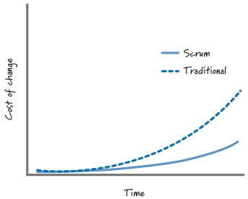
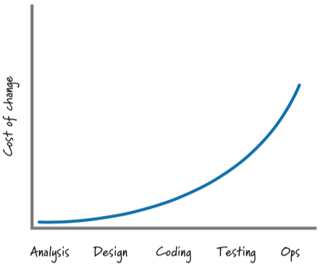
Embrace change in an economically sensible way
When using sequential development, change, as we have all learned, is substantially more expensive late than it is early on
As an example, a change made during analysis might cost $1; that same change made late during testing might cost $1,000
Why is this so? If we make a mistake during analysis and find it during analysis, it is an inexpensive fix. If that same error is not found until design, we have to fix not only the incorrect requirement, but potentially parts of our design based on the wrong requirement

Slide 22
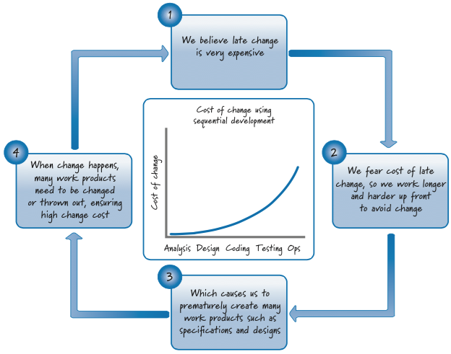
Embrace change in an economically sensible way

Slide 23
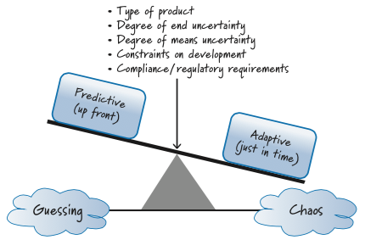
Balancing predictive and adaptive works

Slide 24
Validated Learning
Validate important assumptions fast
Leverage multiple concurrent learning loops
Organize workflow for fast feedback

Slide 25
Validate important assumptions fast
An assumption is a guess, or belief, that is assumed to be true, real, or certain even though we have no validated learning to know that it is true
Plan-driven development is much more tolerant of long-lived assumptions than Scrum
Assumptions represent a significant development risk. In Scrum, we try to minimize the number of important assumptions that exist at any time.

Slide 26
Leverage multiple concurrent learning loops
Assume
Build
Feedback
Inspect
Adapt
When using Scrum, we identify and exploit feedback loops to increase learning. A recurring pattern in this style of product development is to make an assumption (or set a goal), build something (perform some activities), get feedback on what we built, and then use that feedback to inspect what we did relative to what we assumed

Slide 27
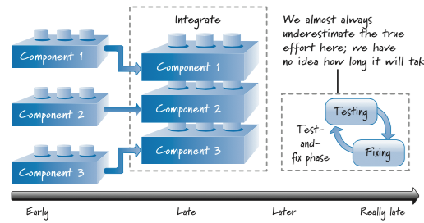
Organize workflow for fast feedback

Slide 28
Work in Process
Use economically sensible batch size
Recognize inventory and manage it for good flow
Focus on idle work, not idle workers
Consider cost of delay

Slide 29
Use economically sensible batch size
Benefit | Description
Reduced cycle time | Smaller batches yield smaller amounts of work waiting to be processed, which in turn means less time waiting for the work to get done. So, we get things done faster.
Reduced flow variability | Think of a restaurant where small parties come and go (they flow nicely through the restaurant). Now imagine a large tour bus (large batch) unloading and the effect that it has on the flow in the restaurant.
Accelerated feedback | Small batches accelerate fast feedback, making the consequences of a mistake smaller.
Reduced risk | Small batches represent less inventory that is subject to change. Smaller batches are also less likely to fail (there is a greater risk that a failure will occur with ten pieces of work than with five).
Reduced overhead | There is overhead in managing large batches—for example, maintaining a list of 3,000 work items requires more effort than a list of 30.
Increased motivation and urgency | Small batches provide focus and a sense of responsibility. It is much easier to understand the effect of delays and failure when dealing with small versus large batches.
Reduced cost and schedule growth | When we’re wrong on big batches, we are wrong in a big way with respect to cost and schedule. When we do things on a small scale, we won’t be wrong by much.

Slide 30
Recognize inventory and manage it for good flow
Product development organizations, generally speaking, are not nearly as cognizant of their work in process
Knowledge assets are far less intrusive, such as code on a disk, a document in a file cabinet, or a visual board on the wall
Inventory (WIP) is a critical variable to be managed during prod- uct development, and the traditional approaches to product development don’t focus on managing it

Slide 31
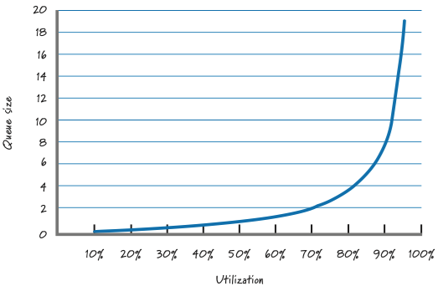
Focus on idle work, not idle workers
Idle work is work that we want to do (such as building or testing something) but can’t do because something is preventing us
Idle workers, on the other hand, are people who have available capacity to do more work because they are not currently 100% utilized
The idle work (delayed work) grows exponentially once we get into the high levels of utilization. And that idle work can be very expensive, frequently many times more expensive than the cost of idle workers

Slide 32
Consider Cost of Delay
Parameter | Value
Duration with full-time documenter | 12 months
Duration with documenter assigned at the end (when we reach the state of “all but documented”) | 14 months
Cycle-time cost for doing documentation at the end | 2 months
Cost of delay, per month | $250K
Total cost of delay | $500K
Annual fully burdened cost of documenter | $90K
Monthly fully burdened cost of documenter | $7.5K
Cost for full-time documenter | $90K
Cost for documenter if assigned at end | $15K
Incremental cost for full-time documenter | $75K

Slide 33
Progress
Adapt to real-time information and replan
Measure progress by validating working assets
Focus on value-centric delivery

Slide 34
Adapt to real-time information and replan
In a plan-driven, sequential process, the plan is the authoritative source on how and when work should occur. As such, conformance to the plan is expected
In Scrum we believe that unbridled faith in the plan will frequently blind us to the fact that the plan might be wrong
On a Scrum development effort our goal is not to conform to some plan, some up-front prediction of how we thought things might go. Instead, our goal is to rapidly replan and adapt to the stream of economically important information that is continuously arriving during the development effort

Slide 35
Measure progress by validating working assets
Progress during a sequential, plan-driven development effort is demonstrated by completing a phase and being permitted to enter the next phase. As a result, if each phase starts and completes as expected, the product development effort might seem to be progressing quite well
With Scrum, we measure progress by building working, validated assets that deliver value and that can be used to validate important assumptions
This gives us the feedback to know what the right next step is. In Scrum, it’s not about how much work we start; it’s all about what customer-valuable work we finish.

Slide 36
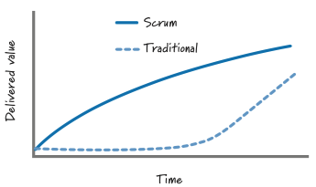
Focus on value-centric delivery
Plan-driven, sequential development focuses on diligently following the process. By its very structure, the integration and delivery of features during sequential development happen at the end of the effort
Scrum, on the other hand, is a customer-value-centric form of development. It is based on a prioritized, incremental model of delivery in which the highest-value features are continuously built and delivered in the next iteration

Slide 37
Progress
Go fast but never hurry
Build in quality
Employ minimally sufficient ceremony

Slide 38
Go fast but never hurry
Plan-driven development believes that if we follow the plan and do things right the first time, we’ll avoid costly and time-consuming rework. Moving from step to step quickly is of course desirable, but it isn’t a principal goal
In Scrum, one core goal is to be nimble, adaptable, and speedy. By going fast, we deliver fast, we get feedback fast, and we get value into the hands of our customers sooner. Learning and reacting quickly allow us to generate revenue and/or reduce costs sooner

Slide 39
Build in quality
During plan-driven development, the belief is that through careful, sequential performance of work we get a high-quality product. However, we can’t actually verify this quality until we do the testing of the integrated product, which occurs during a late phase of the process
In Scrum, quality isn’t something a testing team “tests in” at the end; it is something that a cross-functional Scrum team owns and continuously builds in and verifies every sprint. Each increment of value that is created is completed to a high level of confidence and has the potential to be put into production or shipped to customers

Slide 40
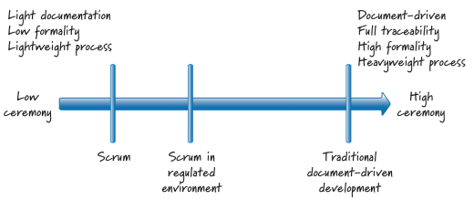
Employ minimally sufficient ceremony
Plan-driven processes tend to be high-ceremony, document-centric, process-heavy approaches. A side effect of Scrum’s being value-centric is that very little emphasis is put on process-centric ceremonies
In Scrum, our goal is to eliminate unnecessary formality. Therefore, we set the ceremonial bar at a low level, one that is minimally sufficient (some call it barely sufficient) or good enough

Slide 41
Thank you

